Slide 1
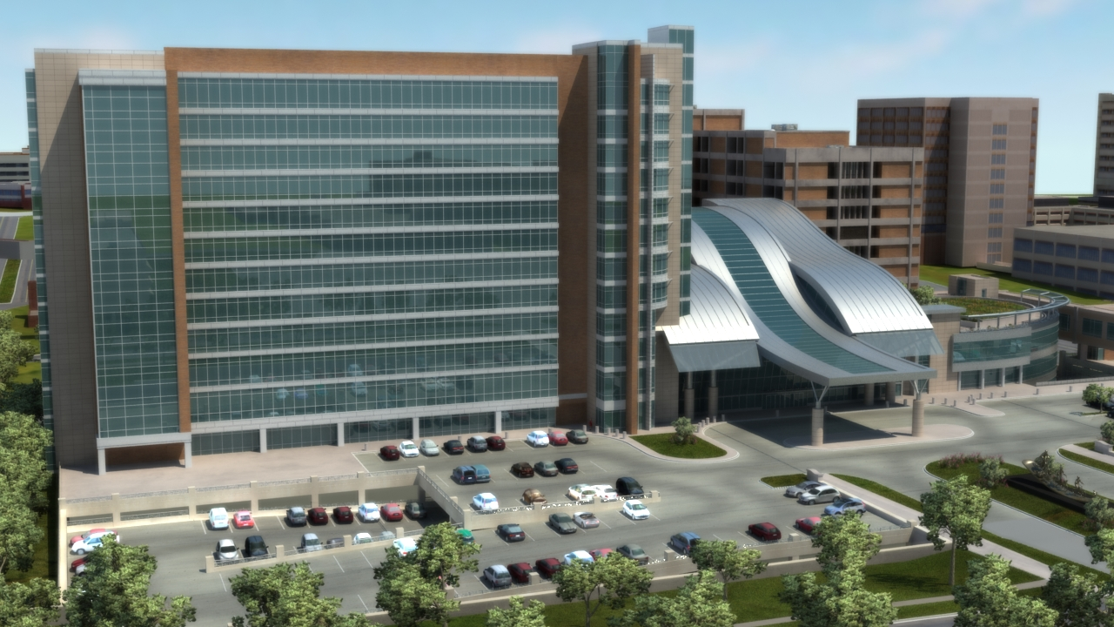
Oklahoma University Children’s Medical Office Building
AE Senior Thesis Final Report
April 14, 2014
Jonathan Ebersole
Structural Option
Dr. Hanagan
Oklahoma City, Oklahoma

Slide 2
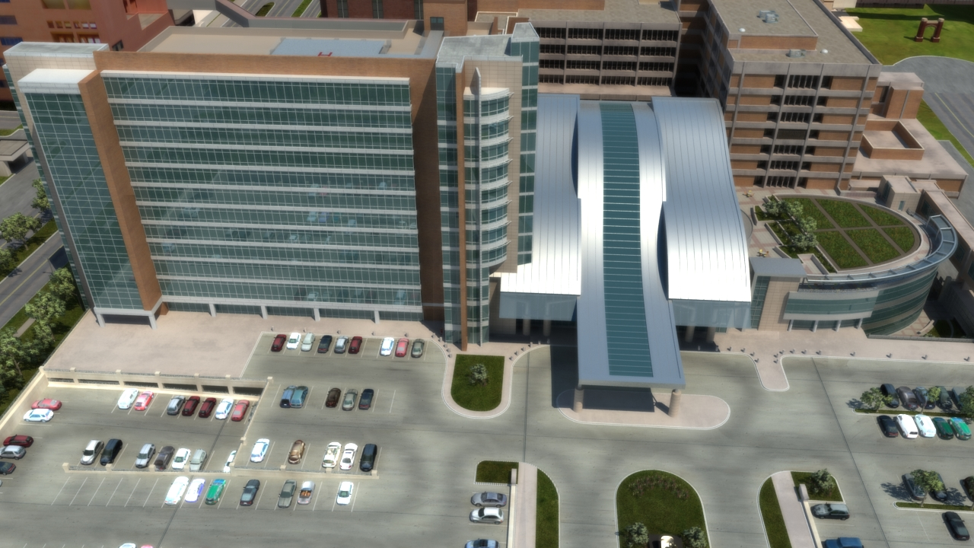
Introduction
  Building Statistics
  Project Team
  Existing Structure
Proposal
Structural Depth
Architectural Breadth
Construction Breadth
Conclusion
Building Statistics
Location: 1200 North Children’s Avenue, Oklahoma City, Oklahoma
Occupancy: Office
Size: 320,000 gsf
Height: 12 stories for a total of 172 ft.
Construction Dates: February 2007- Spring 2009
Building Cost: $59,760,000
Delivery Method: Design-Bid-Build

Slide 3
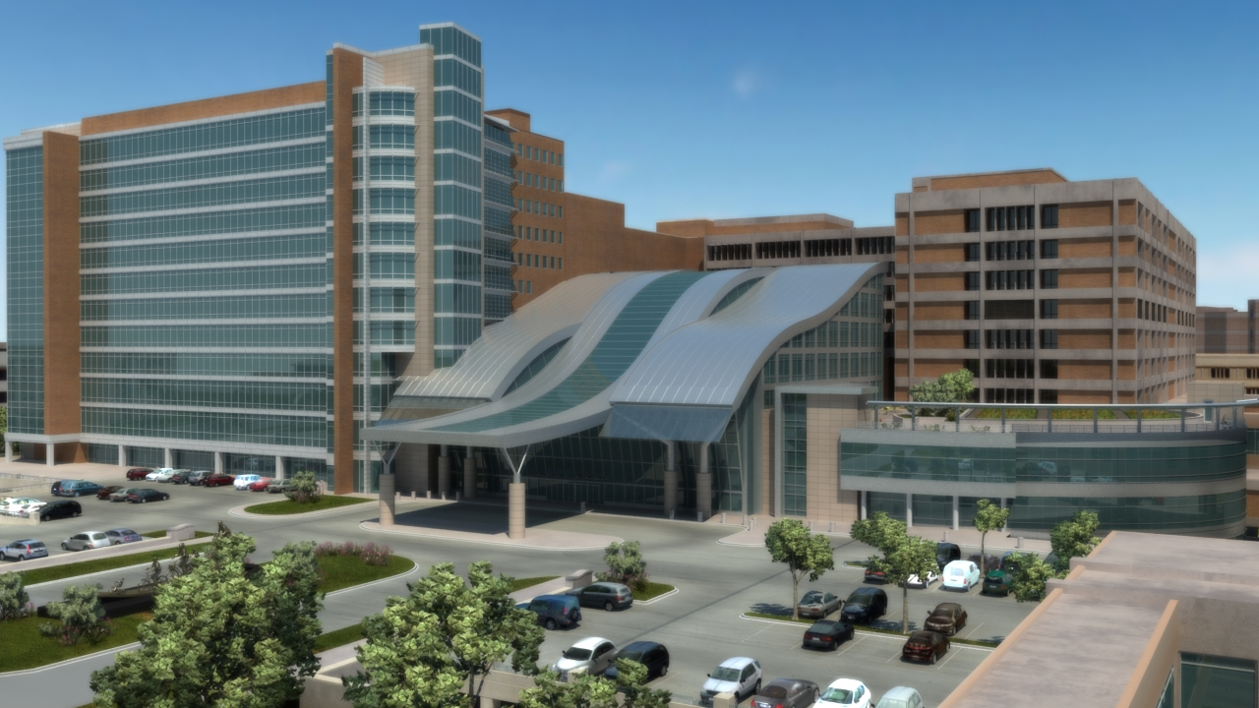
Introduction
  Building Statistics
  Project Team
  Existing Structure
Proposal
Structural Depth
Architectural Breadth
Construction Breadth
Conclusion
Project Team
Owner: University Hospitals Trust
Construction Manager: Flintco, Inc.
Project Architect: Miles Associates
Structural Engineer: Zahl-Ford Inc.
MEP Engineer: ZRHD, P.C.
Civil Engineer: Smith, Roberts, Baldischwiler, Inc.

Slide 4
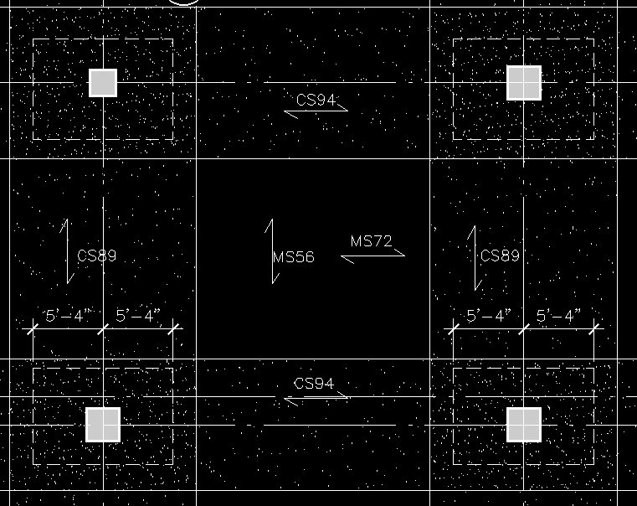
Introduction
  Building Statistics
  Project Team
  Existing Structure
Proposal
Structural Depth
Architectural Breadth
Construction Breadth
Conclusion
Existing Building Structure
Typical Bay
Gravity
Reinforced, cast-in-place concrete
Foundations
  Drilled piers, spread footings, and grade beams
Two way flat slab system with drop panels
  10” slab with 4” drop panels
Exterior Beams
26’
32’

Slide 5
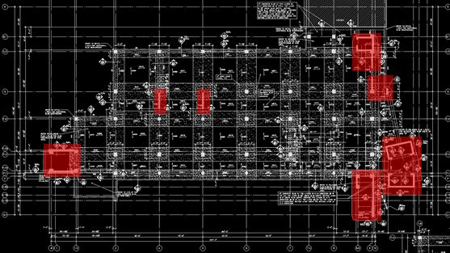
Introduction
  Building Statistics
  Project Team
  Existing Structure
Proposal
Structural Depth
Architectural Breadth
Construction Breadth
Conclusion
Existing Building Structure
Lateral Layout
Lateral
Reinforced cast-in-place concrete shear walls
  Located in stairwells, elevator shafts, and center of floor plan
  Typically 12” thick
Moment frames located along the floor plan perimeter
N

Slide 6
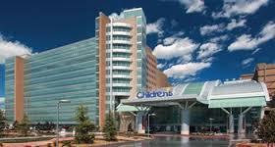
Introduction
Proposal
  Problem Statement
  Depth Introduction
  Breadth Introduction
Structural Depth
Architectural Breadth
Construction Breadth
Conclusion
Problem Statement
Reduce overall building costs
Reduce the schedule duration
Develop an economical steel system
Maintain a low impact on the building architecture
http://www.metalconstructionnews.com/articles/columns/high-flying-inspiration.aspx

Slide 7
Introduction
Proposal
Structural Depth
  Design Loads
  RAM Model
  Composite Steel Redesign
  Steel Joist Redesign
  Lateral System Redesign
  Drift Comparison
Architectural Breadth
Construction Breadth
Conclusion
Design Loads
Gravity Loads
Lateral Load Base Shears
Floors
Live Load | 80 psf
Superimposed Dead Load | 15 psf
Flooring | 2 psf
Wind Loads
Wind N-S | 430 kips
Wind E-W | 942 kips
Seismic
Seismic N-S | 447 kips
Seismic E-W | 447 kips
Roof
Roof Live Load | 20 psf
Snow Load | 10 psf
Green Roof Dead Load | 30 psf
Superimposed Dead Load | 15 psf
Wind E-W controls
Additional Loads
Helicopter Pad Dead Load | 8.33 kips
Ambulance Bay Live Load | 60 psf

Slide 8
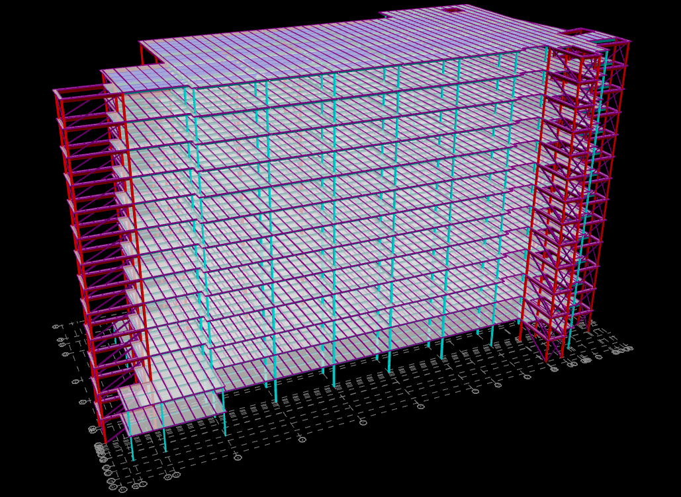
Introduction
Proposal
Structural Depth
  Design Loads
  RAM Model
  Composite Steel Redesign
  Steel Joist Redesign
  Lateral System Redesign
  Drift Comparison
Architectural Breadth
Construction Breadth
Conclusion
RAM Model
Model Assumptions
Columns are considered as pinned connections at the base
Wind Loads are to be applied at the center of pressure
Each floor diaphragm is considered rigid
N

Slide 9
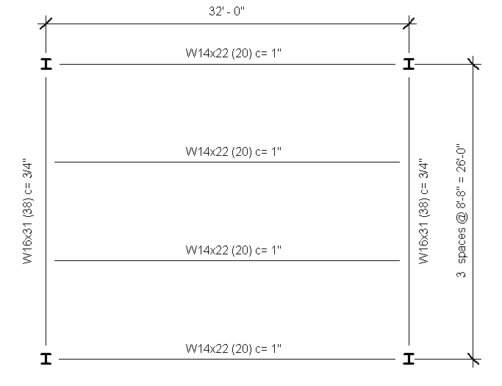
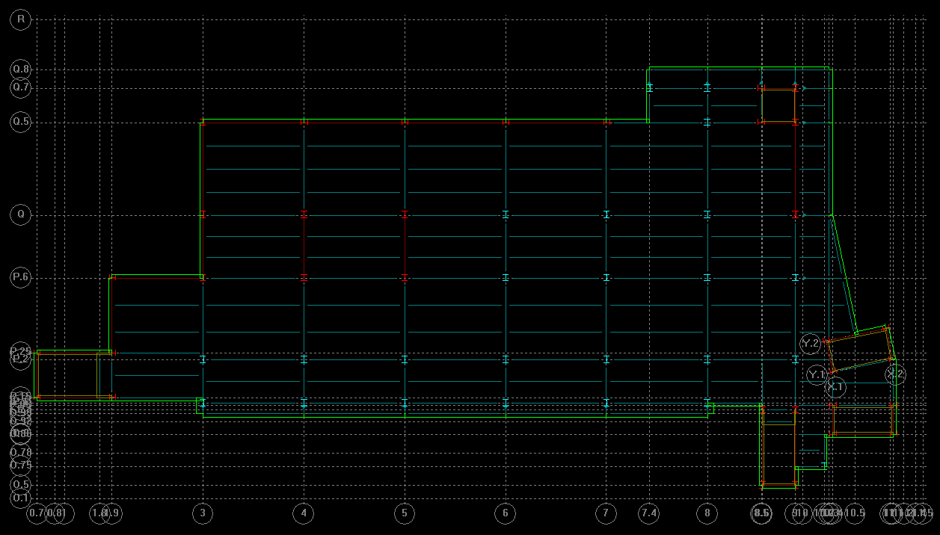
Typical Bay
Introduction
Proposal
Structural Depth
  Design Loads
  RAM Model
  Composite Steel Redesign
  Steel Joist Redesign
  Lateral System Redesign
  Drift Comparison
Architectural Breadth
Construction Breadth
Conclusion
Composite Steel Floor Redesign
Typical Bay
  1.5 VLR 22 gauge composite deck
    3 ¼” lightweight topping
    Unshored, 3 span construction
  Beams
    W14x22 with 20 studs and a 1” camber
  Girders
    W16x31 with 38 studs and a ¾” chamber
  Beams, girders, and columns are to be fireproofed for a two hour fire rating
N

Slide 10
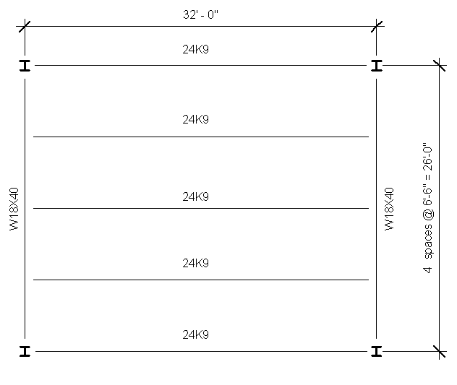
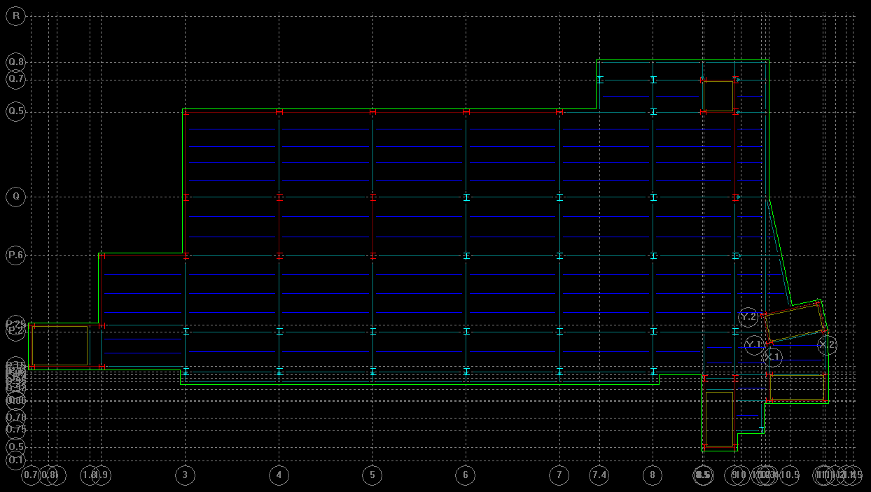
Introduction
Proposal
Structural Depth
  Design Loads
  RAM Model
  Composite Steel Redesign
  Steel Joist Redesign
  Lateral System Redesign
  Drift Comparison
Architectural Breadth
Construction Breadth
Conclusion
Steel Joist Roof Redesign
Typical Roof Bay
Typical Bay
  1.5 B 22 gauge roofing deck
    Unshored, 3 span construction
  Joists
    24K9 joists
  Girders
    W18x40
  Roof deck, joists, girders, and columns will be fireproofed for a two hour fire rating
N

Slide 11
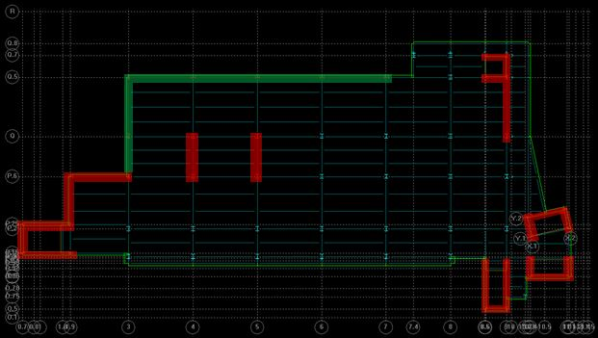
Introduction
Proposal
Structural Depth
  Design Loads
  RAM Model
  Composite Steel Redesign
  Steel Joist Redesign
  Lateral System Redesign
  Drift Comparison
Architectural Breadth
Construction Breadth
Conclusion
Lateral System Redesign
Lateral System Layout
Concentric, diagonal braced frames
  Located in existing shear wall locations
  Consists of square HSS steel tubes
Additional moment frames are needed
  Located along the eastern wall
  Moment frames where used to minimize the impact on the architecture
Concentric Braced Frames
N
Additional Frames

Slide 12
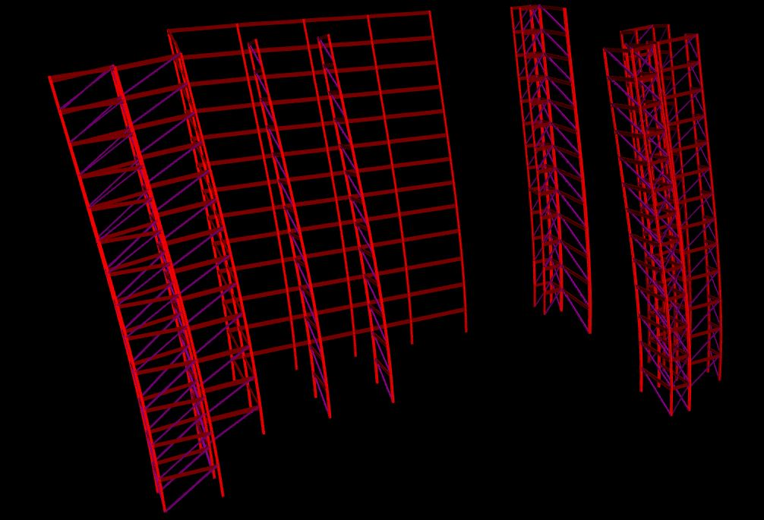
Introduction
Proposal
Structural Depth
  Design Loads
  RAM Model
  Composite Steel Redesign
  Steel Joist Redesign
  Lateral System Redesign
  Drift Comparison
Architectural Breadth
Construction Breadth
Conclusion
Drift Comparison
Building Drift Under Controlling Case
Existing concrete lateral system drift: 4.77 inches
Proposed steel lateral system drift: 4.75 inches
IBC 2009 allowable building drift: 4.98 inches
N

Slide 13
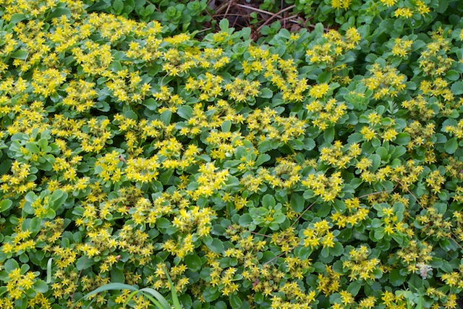
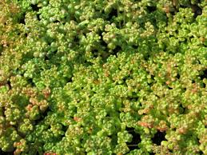
Introduction
Proposal
Structural Depth
Architectural Breadth
  Plant selection
  Material Selection
  Impact on Structural System
  Green Roof Cost Analysis
Construction Breadth
Conclusion
Plant Selection
Oklahoma City hardiness zone: 7a and 7b
  Identifies the appropriate plants for a specific environment
Sedum plants are used
  Hardy plants that can survive a variety of different environments
  Can grow in shallow soil depths
  Ability to resist droughts
Sedum Floriferum
http://macgardens.org/?m=201306
Sedum Oreganum
http://www.greatcity.org/

Slide 14
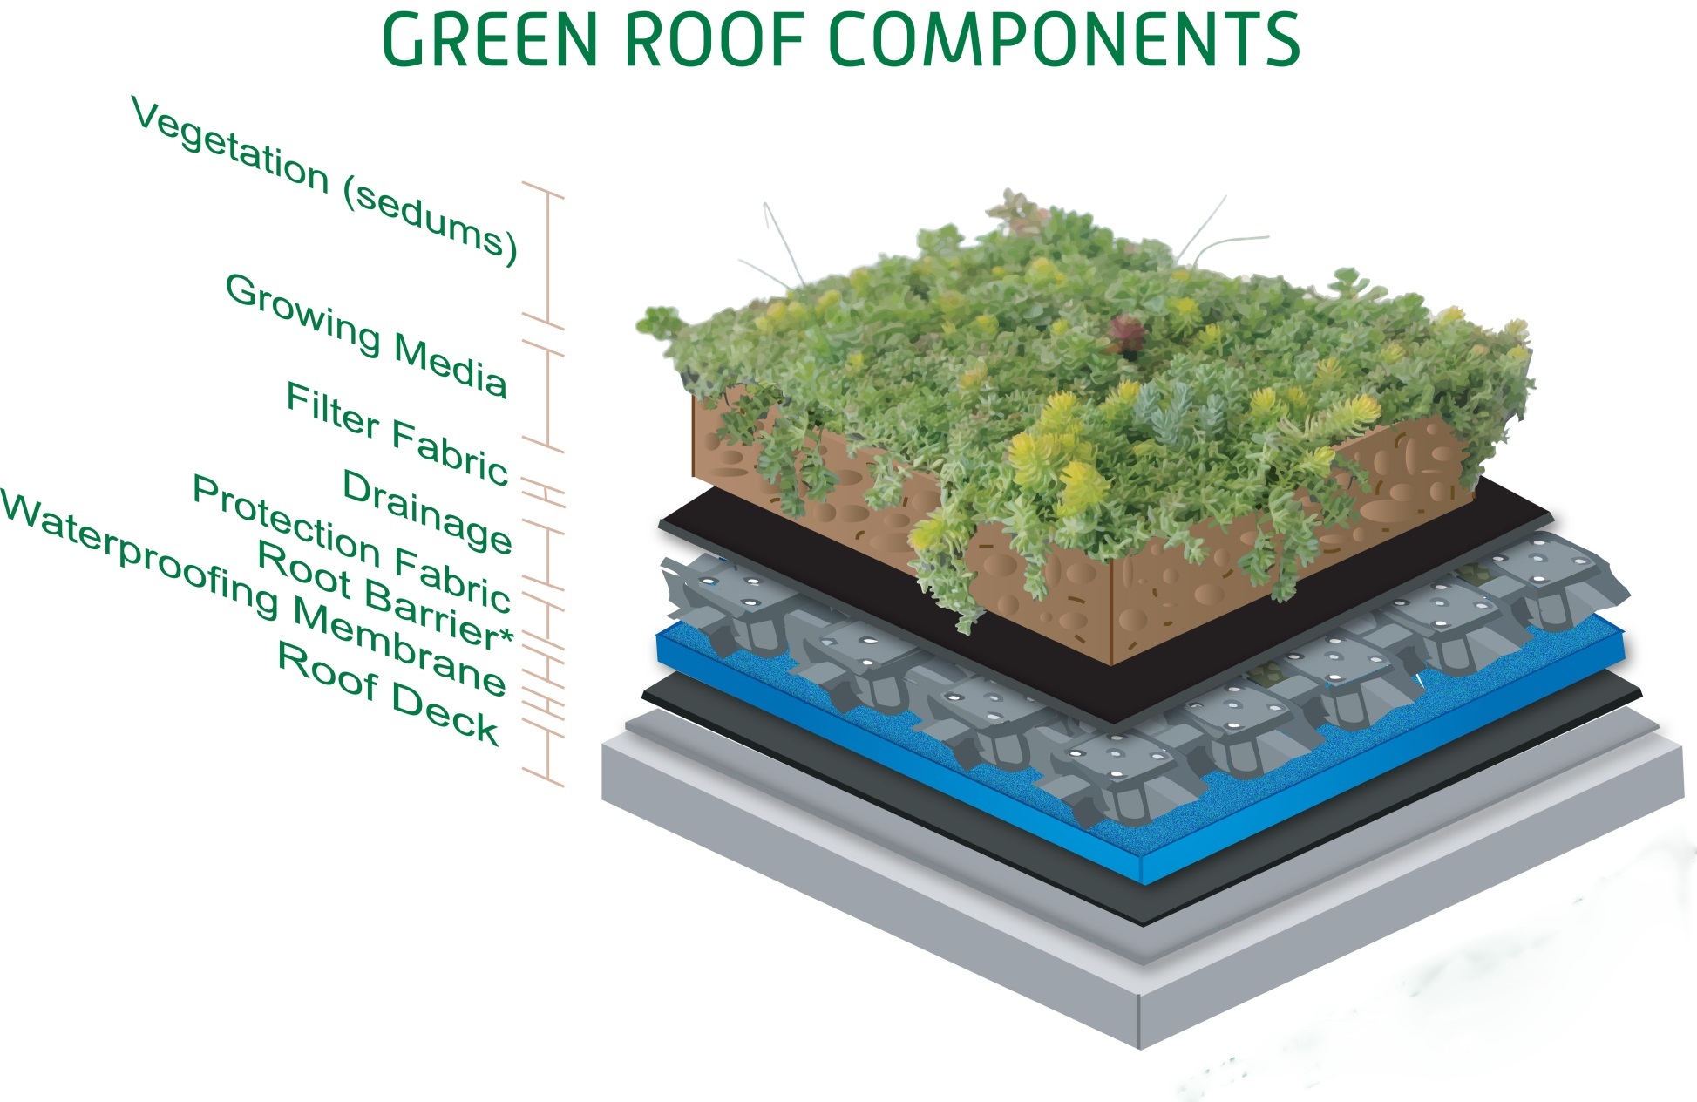
Introduction
Proposal
Structural Depth
Architectural Breadth
  Plant selection
  Material Selection
  Impact on Structural System
  Green Roof Cost Analysis
Construction Breadth
Conclusion
Material Selection
Growing Medium
  Rooflite Extensive MCL
Filter Fabric
  Green Roof Solutions FF35
Drainage Panel
  Green Roof Solutions GRS 32
Image obtained from http://www.vegetalid.us/green-roof-systems/green-roof-101/what-is-a-green-roof

Slide 15
Introduction
Proposal
Structural Depth
Architectural Breadth
  Plant selection
  Material Selection
  Impact on Structural System
  Green Roof Cost Analysis
Construction Breadth
Conclusion
Material Selection
Root Barrier
  Green Roof Solutions RB20
Waterproof Membrane
  Kemper System Kempero 2K-PUR
Rigid Insulation
  DOW Building Solutions Highload 60 Insulation
Vapor Barrier
  Roof Aqua Guard BREA
Image obtained from http://www.vegetalid.us/green-roof-systems/green-roof-101/what-is-a-green-roof

Slide 16
Introduction
Proposal
Structural Depth
Architectural Breadth
  Plant selection
  Material Selection
  Impact on Structural System
  Green Roof Cost Analysis
Construction Breadth
Conclusion
Impact on the Structural System
Material | Weight
Vegetation | 2 psf
Growing Media | 17 psf
Filter Fabric | 0.024 psf
Drainage Panel (Including Water) | 2 psf
Root Barrier | 0.05 psf
Water Proof Membrane | 0.05 psf
Total | 22 psf
Initial dead load estimation for the green roof was 30 psf.
The total dead load for the green roof is 22 psf
The estimated dead load is conservative compared to the actual dead load

Slide 17
Introduction
Proposal
Structural Depth
Architectural Breadth
  Plant selection
  Material Selection
  Impact on Structural System
  Green Roof Cost Analysis
Construction Breadth
Conclusion
Green Roof Cost Analysis
Green Roof
 | Unit | Quantity | Waste Factor | Unit Price | Labor | Equipment | Total
Vegetation | S.F. | 22705.50 | 1.00 | 2.50 | 0.33 | 0.00 | 64256.57
Growing Medium | S.F. | 22705.50 | 1.00 | 0.25 | 0.53 | 0.41 | 27019.55
Filter Fabric | S.F. | 22705.50 | 1.00 | 0.26 | 3.88 | 0.51 | 105580.58
Drainage Panel | S.F. | 22705.50 | 1.00 | 2.70 | 0.67 | 0.00 | 76517.54
Root Barrier | S.F. | 22705.50 | 1.00 | 0.70 | 0.77 | 0.00 | 33377.09
Water Proof Membrane | S.F. | 22705.50 | 1.00 | 0.26 | 3.88 | 0.51 | 105580.58
 |  |  |  |  |  | Total: | $412,331.88
Green roofs have a higher initial costs compared to a standard built up roof
Using RS Means Cost Construction Data, the total additional cost for the green roof is $412,000.00

Slide 18
Introduction
Proposal
Structural Depth
Architectural Breadth
Construction Breadth
  Cost Comparison
  Schedule Comparison
Conclusion
Cost Comparison
Steel Cost Summary
Steel Beams | $2,230,000.00
Steel Columns | $1,170,000.00
Steel Braces | $250,000.00
Steel Decking | $756,000.00
Concrete Topping | $365,000.00
Welded Wire Fabric | $120,000.00
Steel Joists | $29,000.00
Fireproofing | $142,000.00
Shear Connectors | $63,000.00
Total | $5,125,000.00
Detailed cost analysis using RS Means for each system
Original concrete design estimate: $9,055,000.00
Proposed steel design estimate: $5,125,000.00
Cost is significantly reduced
Concrete Cost Summary
Cost of Concrete | $2,025,000.00
Cost of Formwork | $5,380,000.00
Cost of Reinforcement | $1,650,000.00
Total | $9,055,000.00

Slide 19
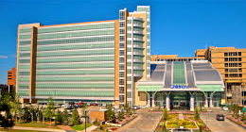
Introduction
Proposal
Structural Depth
Architectural Breadth
Construction Breadth
  Cost Comparison
  Schedule Comparison
Conclusion
Schedule Comparison
Schedule determined from RS Means
Original Concrete System
  Assumed three crews to decrease schedule times
  710 days to complete
Proposed Steel System
  Assumed one crew erecting the steel
  189 days to complete
http://www.projsolco.com/portfolio/healthcare-imaging-solutions

Slide 20
Introduction
Proposal
Structural Depth
Architectural Breadth
Construction Breadth
Conclusion
  Design Conclusion
  Acknowledgements
  Questions
Design Conclusion
Goals
Results
Reduce overall building costs
Reduce the schedule duration
Develop an economical steel system
Maintain a low impact on the building architecture
Redesign was more cost effective
The schedule time was reduced
Composite steel with unshored construction
Steel provides an open floor plan
Lateral system has little impact of exterior facade

Slide 21



Introduction
Proposal
Structural Depth
Architectural Breadth
Construction Breadth
Conclusion
  Design Conclusion
  Acknowledgements
  Questions
Acknowledgements
University Hospitals Trust
Miles Associates
Zahl-Ford Inc.
Department of Architectural Engineering
Friends and Family

Slide 22
Introduction
Proposal
Structural Depth
Architectural Breadth
Construction Breadth
Conclusion
  Design Conclusion
  Acknowledgements
  Questions
Questions?

